Slide 1
Integrated Electrical
Multi-tool Board
Team1: Boardbyte
Tanner Gurley
Zia Hosainzada
Humzeh Al-Tamari
Max Djafarov

Slide 3
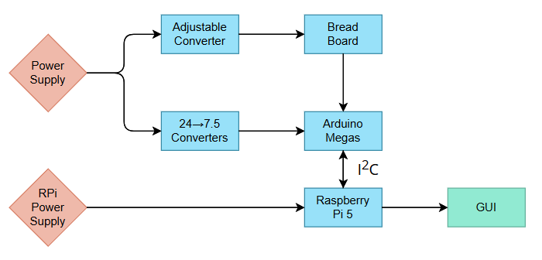
An Overview of the System

Slide 4
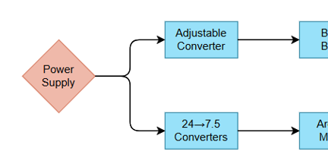
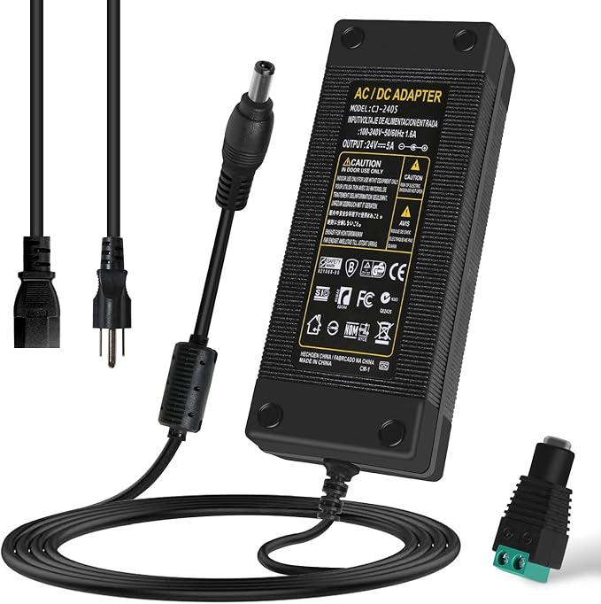
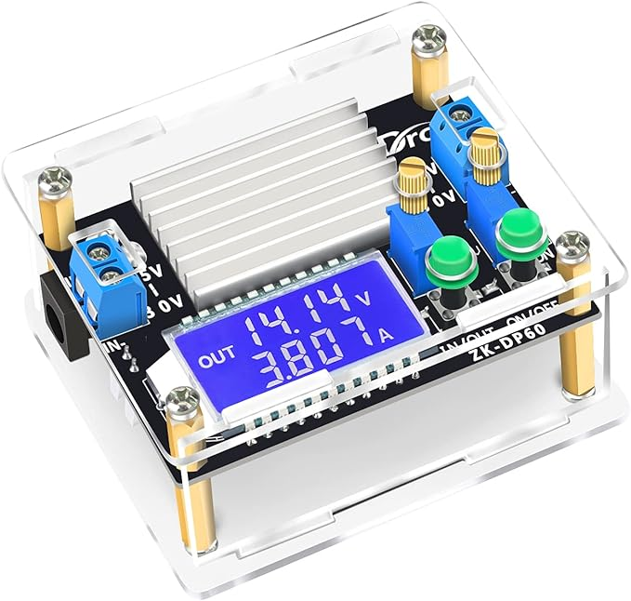
Power Distribution
24V 5A AC/DC Power Supply Converts 120V wall AC to stable 24V DC at 120W and serves as the main power input for the system.
DROK Adjustable Buck Converter (24V → 1.25–24V) Supplies variable voltage to the breadboard rail. Was chosen for its flexibility and built-in LCD for easy testing.

Slide 5
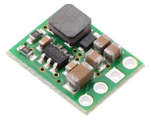
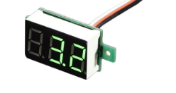
Power Distribution
6 Pololu 7.5V Buck Converters Each powers a separate Arduino Mega Rev3 with a fixed 7.5V output stepped down from the 24V supplied from AC/DC converter.
1 Pololu 7.5V Buck Converter Dedicated to powering a 7-segment LED voltage display.
7-Segment Voltage Display Shows voltage readouts while adjusting display using cabinet buttons with minimal power draw

Slide 6
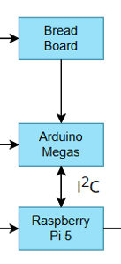
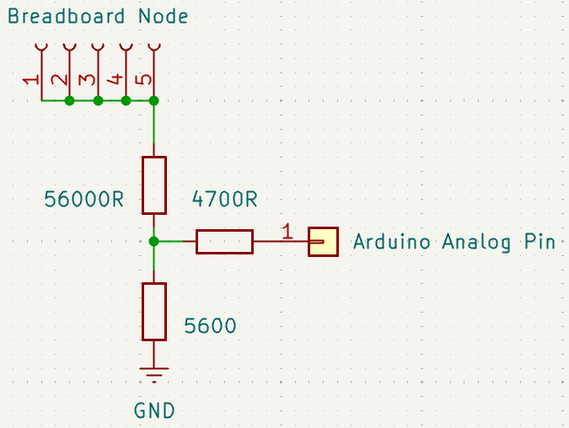
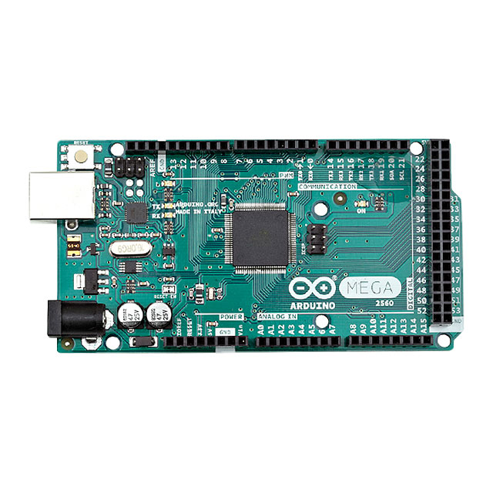
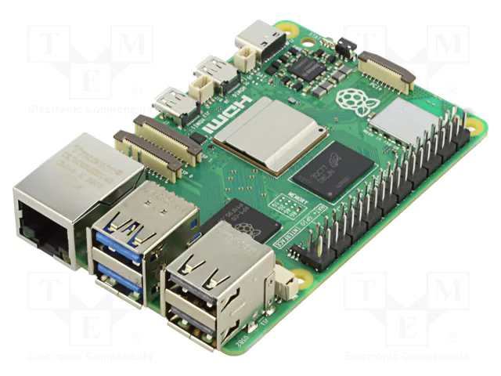
μController Integration
Arduino Mega Rev3 16 Analog Pins that can be programmatically accessed through commands from another device
Raspberry Pi 5 8 Gb RAM and can command multiple device through an I²C connection. Easily interfaced with LCD screen for displaying GUI written in python

Slide 7
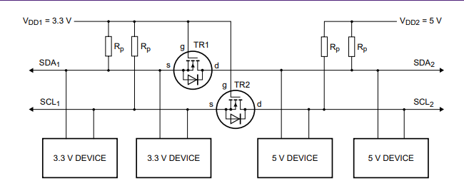
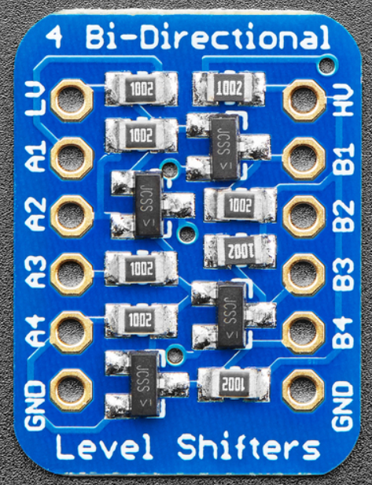
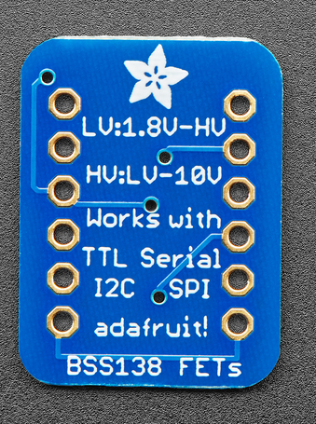
μController Integration
Adafruit 757 4-Channel Bi-Directional Level Shifter allows for I²C enabled devices to share the same bus while enabling two-way communication.

Slide 8
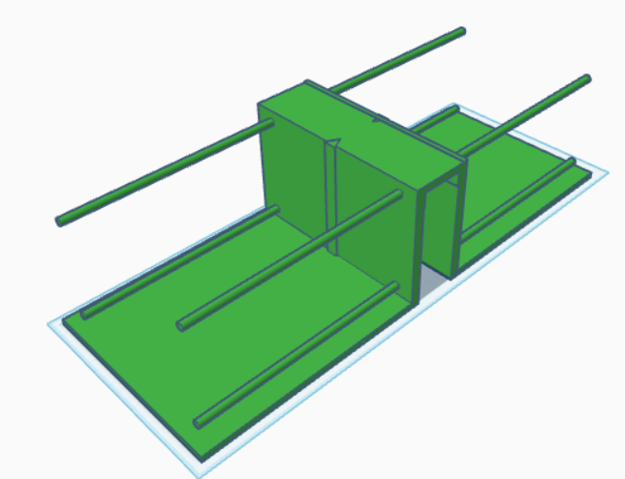
Inner Structure Design

Slide 9
Outer Structure Design

Slide 10
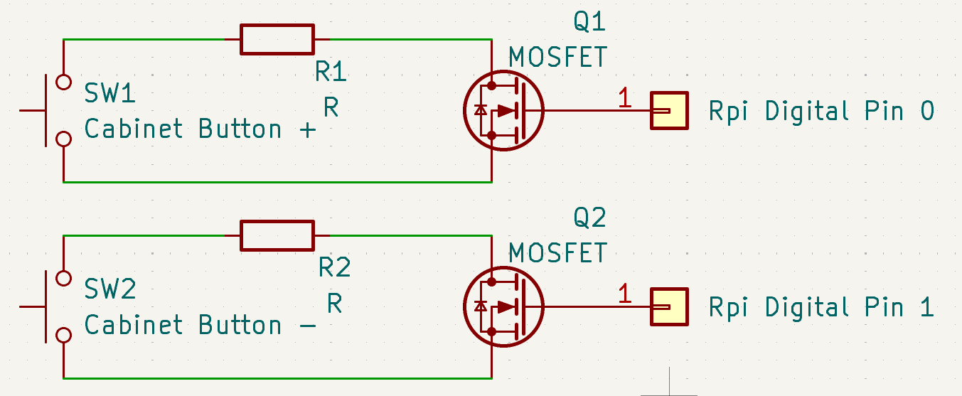
Sweeping Module

Slide 11
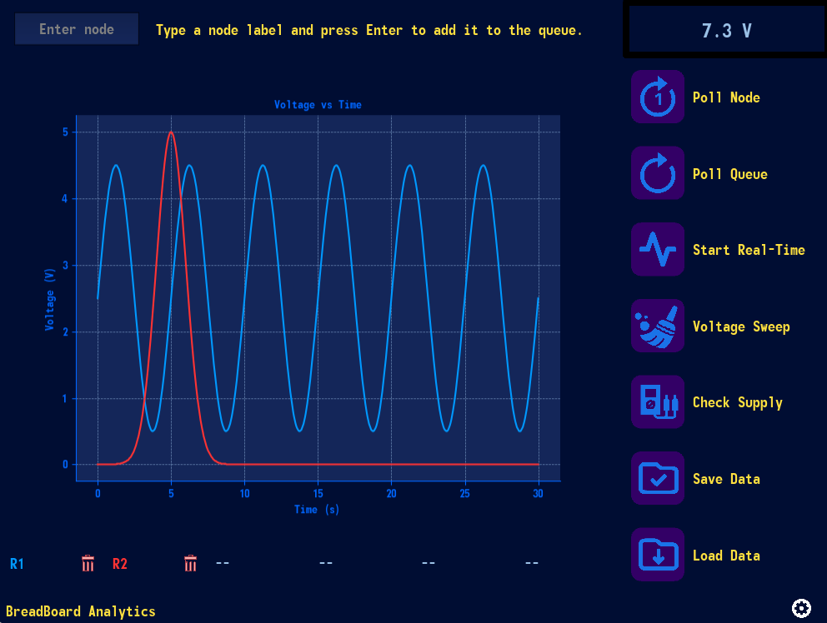
Application GUI

Slide 12
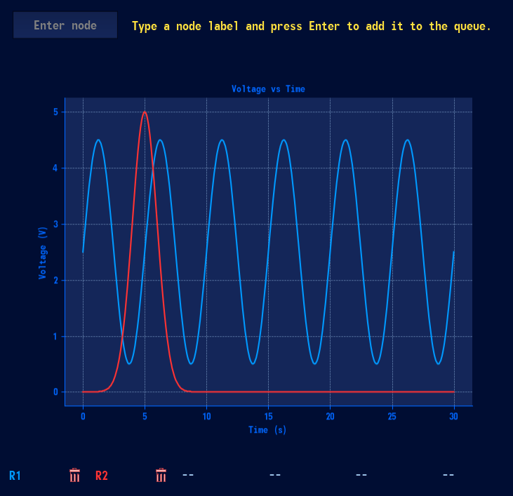
Application Functionality
Node Input Bar Node Input allows for you to add a node to queue or poll the node once to display the current voltage. Polling a node returns a dictionary to RAM that includes the nodes timestamp, name, and voltage. Only allows nodes L2 through L49 and R1 through R48.
R48 will display the board voltage and L1 broke. ☹
Graphing Area Displays voltage over time for queued nodes color coded with the queue display. Hover annotations show the node name and voltage at that time. Log scale toggles, peak detection, and real-time redrawing supported.
Node Queue Display Allows for up to 6 queued nodes. You can click the Node Label to toggle its visibility in the graphing area and press the trash icon to remove its data from memory and the graph.

Slide 13
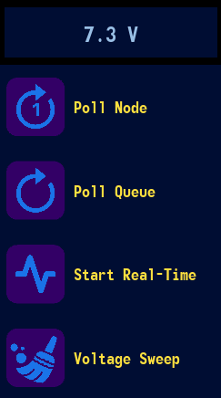
Application Functionality
Voltage Display
Good for testing!
Poll Node Allows you to poll which ever node is currently typed into the Node Input bar and displays its voltage above.
Poll Queue
Allows you to poll the Nodes located in the current queue for an interval over time
Start Real-Time Polling Starts the Real-Time polling functionality. Nodes in queue will start to graph their voltage every interval you set. Allows you to set a max total points on screen and the amount of data held in RAM.
Voltage Sweep
Humzeh will go over this because we are out of room here.

Slide 14
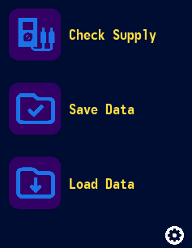
Application Functionality
Check Supply
Displays the current voltage being supplied to the board in the Voltage Display.
Save Data Saves the voltage data being displayed as an .csv file in an app internal /sessions folder. File browser implemented that initializes name of file to timestamp but can be changed to what ever you choose. Saves using timestamp as first key to optimize loading.
Load Data
Allows you to load saved sessions through File Browser into the graphing area to be visualized.
Settings
Export Graph as .PNG or .PDF (WIP)
Toggle Graph Axis for X or Y (BUGGED)
Change Application Theme
Light Mode
Dark Mode
Fallout
Electric Jayhawk (Current)
Paste in Multiple Nodes in Batch Entry

